Slide 1
Project Presentation
FIR Filter Implementation on FPGA
Haochen Wu, Siyuan Zhang, Yihua Liu
December 10th, 2021

Slide 2
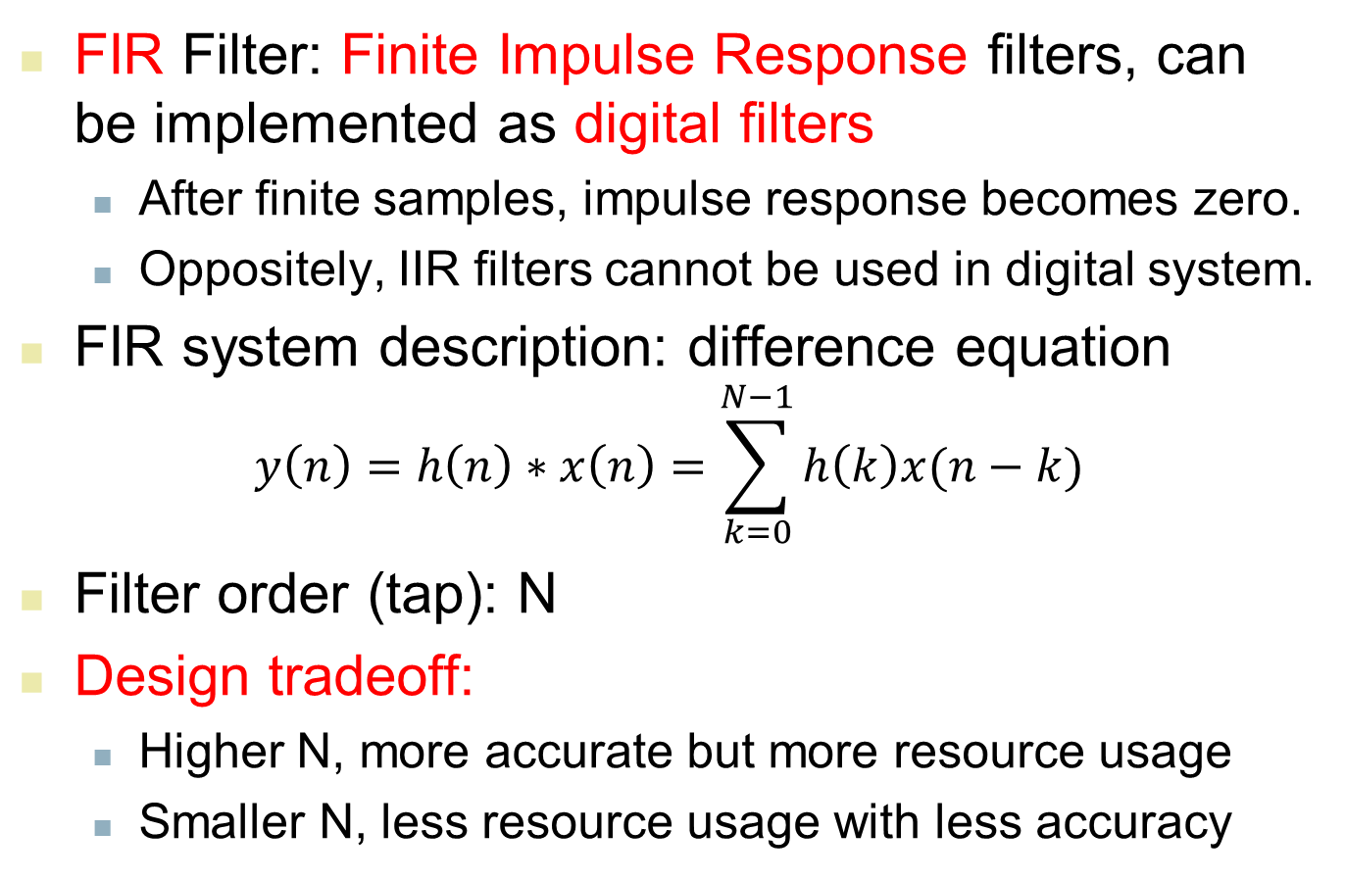
FIR Mathematical Definition
FIR Filter: Finite Impulse Response filters, can be implemented as digital filters
After finite samples, impulse response becomes zero.
Oppositely, IIR filters cannot be used in digital system.
FIR system description: difference equation
$$y\left(n\right)=h\left(n\right)∗x\left(n\right)=\sum_{k=0}^{N−1}{h\left(k\right)x(n−k)}$$
Filter order (tap): N
Design tradeoff:
Higher N, more accurate but more resource usage
Smaller N, less resource usage with less accuracy

Slide 3
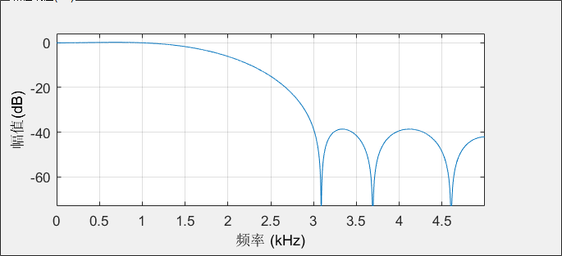
Lowpass Filter Design
Use Matlab filterDesigner toolbox
8-tap lowpass equiripple filter
Digital system sampling frequency Fs: 10kHz
Pass frequency: 1kHZ, cutoff frequency: 3kHz
Frequency response:
Passband
Transition band
Stopband

Slide 4
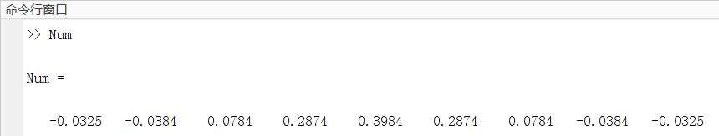
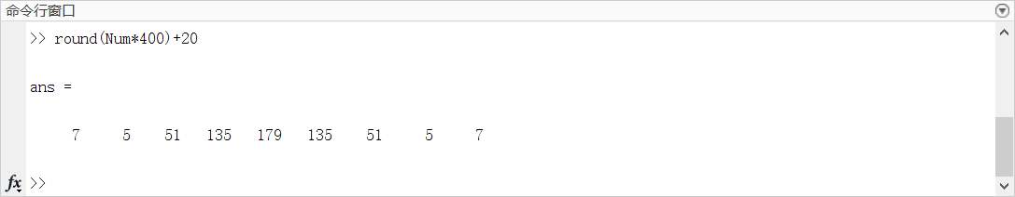
Filtering Coefficients Process
Original coefficients exported from Matlab filterDesigner (“Num” in workspace):
Data process: hard to deal with decimals, multiply and add to round to a positive integer:

Slide 5
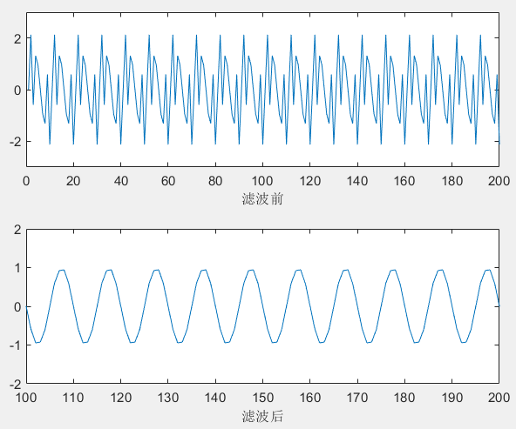
Matlab Simulation
Sampling frequency Fs: 10kHz
Sampling points (digital signal length) N: 4096
Input signal (mixed frequency): 1kHz+3kHz+4kHz
Theoretical lowpass filtering output: 1kHz
Expected filtering result (simulated in Matlab):

Slide 6
Testbench Establishment
Sampling mixed frequency analog signal with Fs=10kHz and N=4096
Round to integer in [0,255]
Store converted digital signal into a text file for subsequent simulation

Slide 7
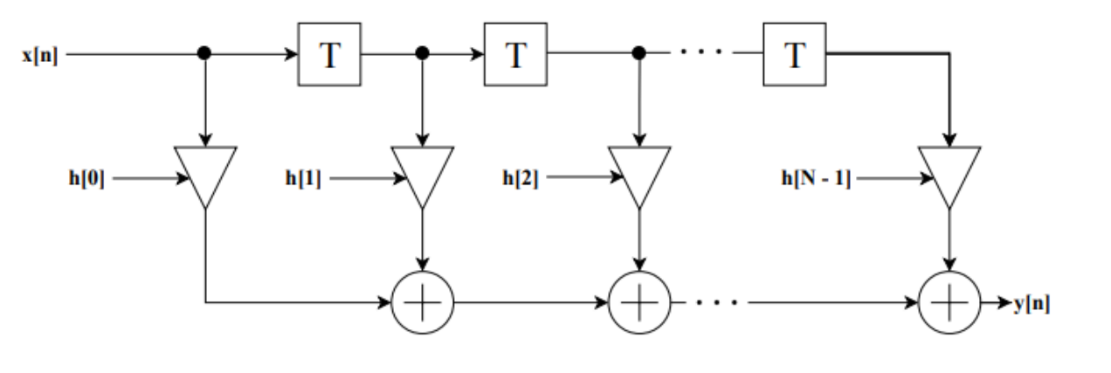
Methodology 1: Direct Form Structure
Directly multiply each delayed input with corresponding coefficient.
Source: https://liu.diva-portal.org/smash/get/diva2:1256720/FULLTEXT01.pdf

Slide 8
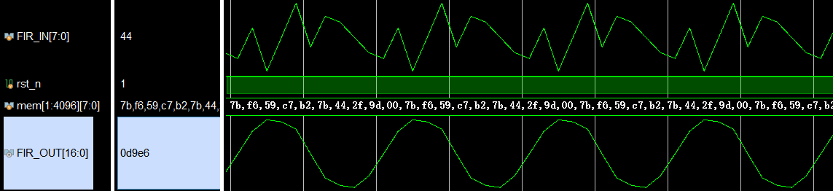
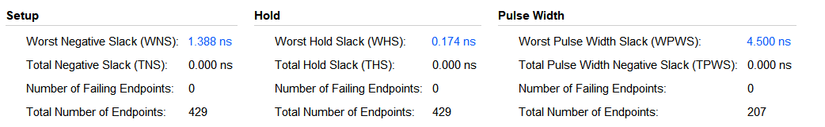
Justification
*Timing constraint: clock cycle = 10ns (100MHz)

Slide 9
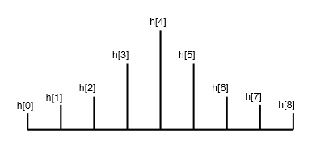
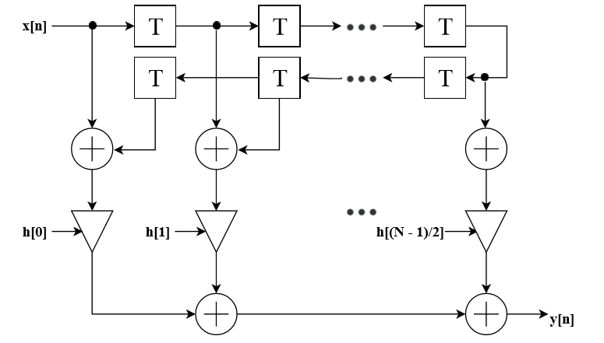
Methodology 2: Symmetry Structure
Make use of impulse response symmetry: h(n) = h(N-n)
Fold the delay pipeline, multiplier usage reduced to half !
Source: https://liu.diva-portal.org/smash/get/diva2:1256720/FULLTEXT01.pdf

Slide 10
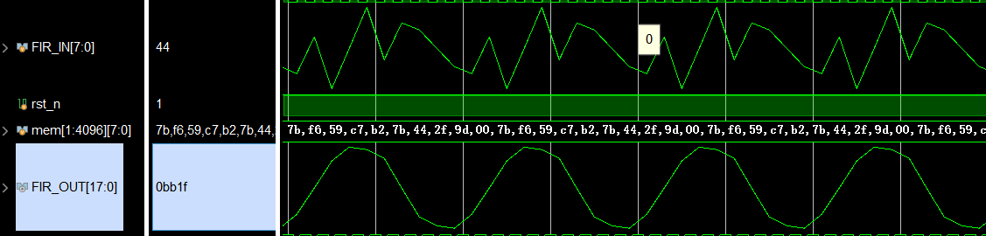
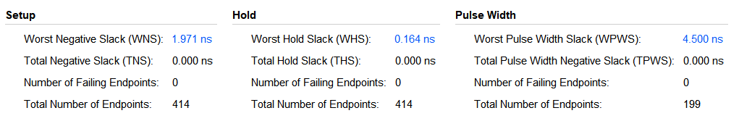
Justification
*Timing constraint: clock cycle = 10ns (100MHz)

Slide 11
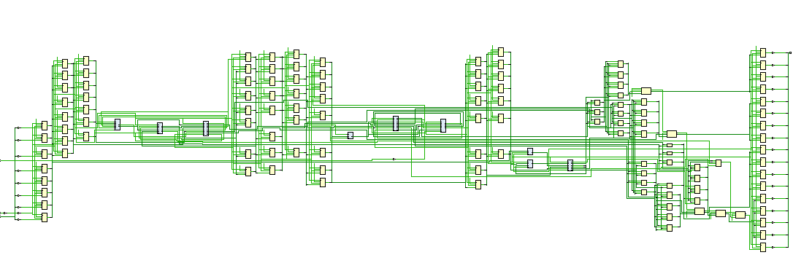
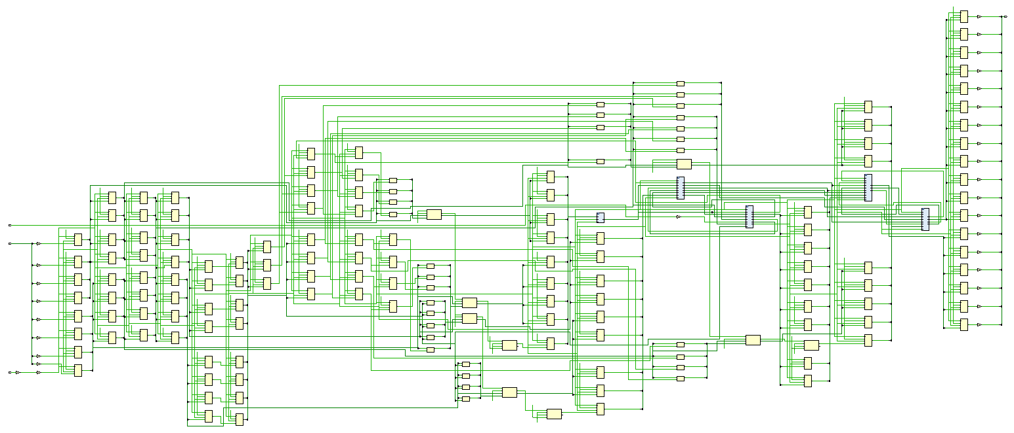
Direct VS. Symmetry (Structure)
Direct form structure
Symmetry structure
Source: UMJI Canvas/Soc Product Manuals/ Telum_IBM

Slide 12
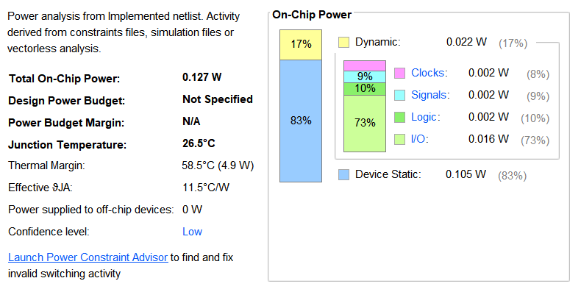
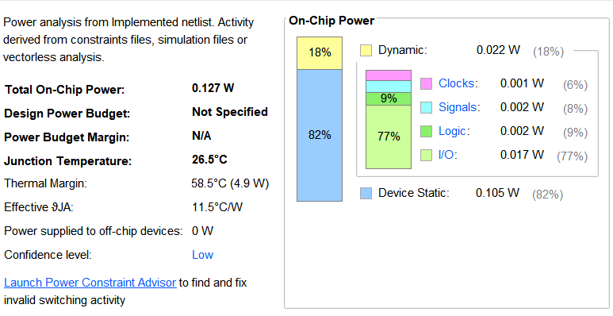
Direct VS. Symmetry (Power)
Direct form structure
Symmetry structure

Slide 13
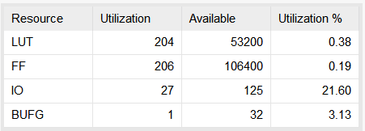
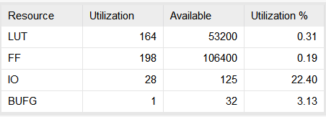
Direct VS. Symmetry (Usage)
Direct form structure
Symmetry structure
Symmetry structure uses 19.6% less LUTs

Slide 14
Direct VS. Symmetry (Timing)
Direct form structure
Symmetry structure

Slide 15
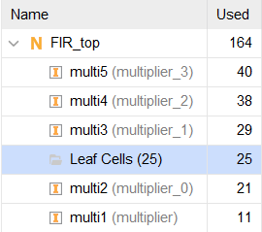
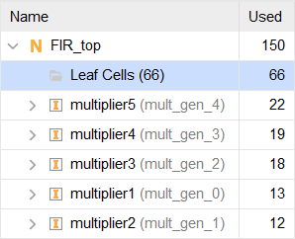
Another Trial: Use IP Cores
Constant coefficient multiplication in FIR filter: possible logic reduction using Multiplier IP rather than general x*y multiplication synthesis.
Replace multipliers in symmetry structure by IPs.
LUTs as logic when
general multiplication
LUTs as logic using
constant multiplication IP
Reduction of LUT usage in multipliers

Slide 16
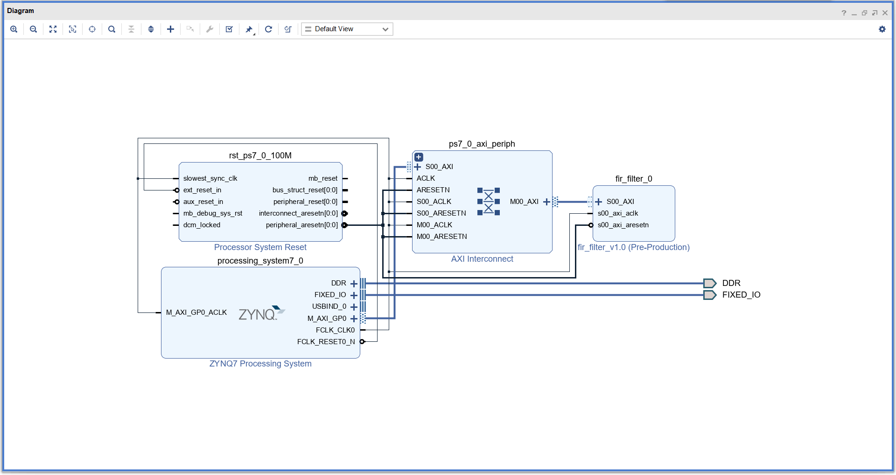
Implementation on ZYNQ
Design of IP

Slide 17
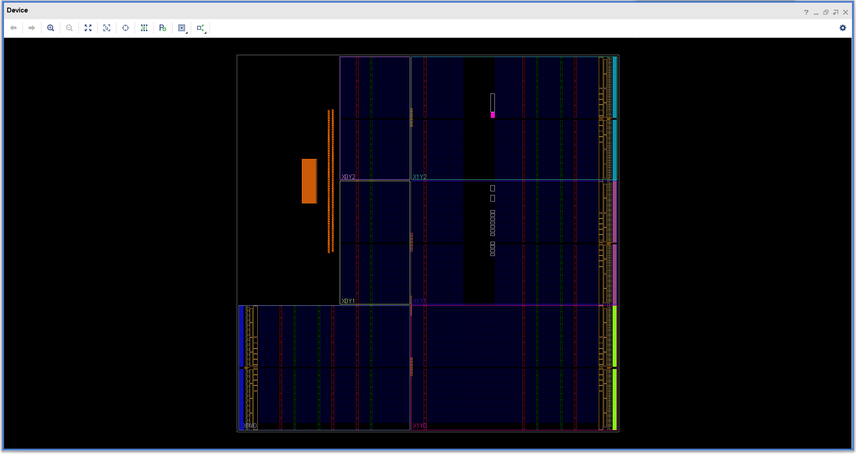
Implementation on ZYNQ
Synthesis

Slide 18
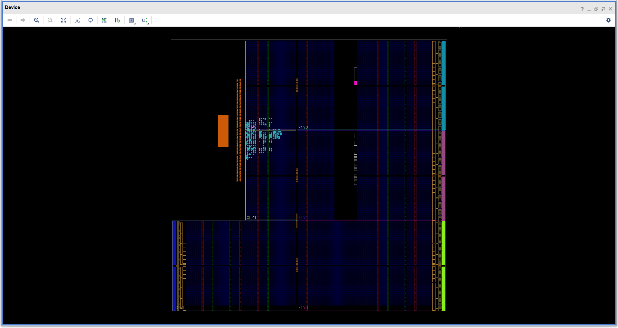
Implementation on ZYNQ
Implementation

Slide 19
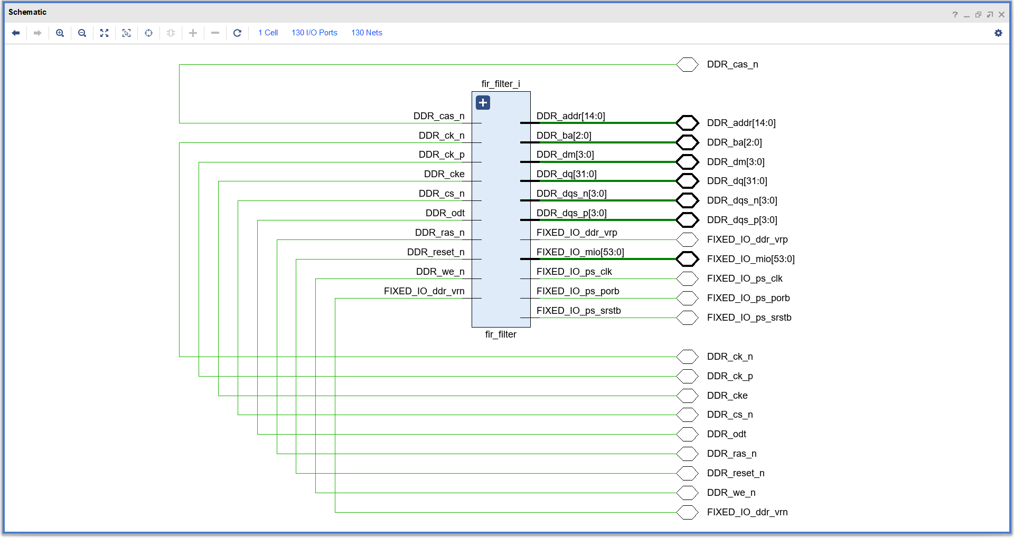
Implementation on ZYNQ
Schematic

Slide 20
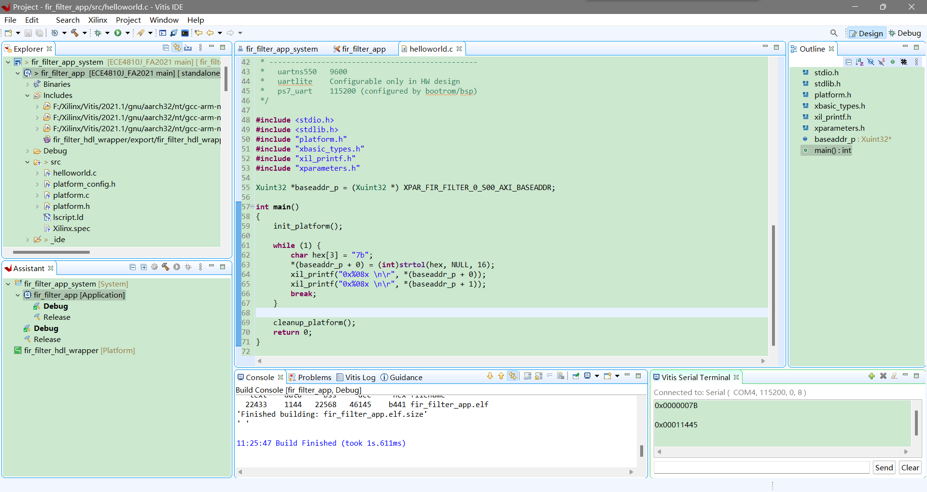
Implementation on ZYNQ
Vitis Application

Slide 21
References
J. Yu, H. Zhong and P. Yan, "Implementation of FIR filter based on Xilinx IP core," 2020 2nd International Conference on Information Technology and Computer Application (ITCA), 2020, pp. 79-85, doi: 10.1109/ITCA52113.2020.00024.
https://liu.diva-portal.org/smash/get/diva2:1256720/FULLTEXT01.pdf

